Slide 1
// Functions that take no arguments
#include <iostream>
using namespace std;
void function1();
void function2( void );
int main()
{
function1();
function2();
return 0;
}
void function1()
{
cout << "function1 takes no arguments" << endl;
}
void function2( void )
{
cout << "function2 also takes no arguments" << endl;
}

Slide 2
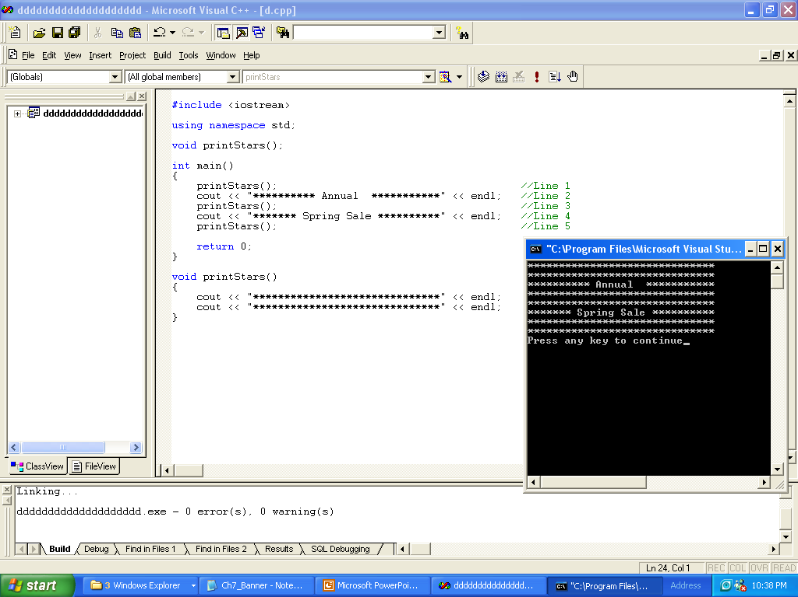

Slide 3
Example
#include <iostream>
using namespace std;
void printStars();
int main()
{
printStars(); //Line 1
cout << "********** Annual ***********" << endl; //Line 2
printStars(); //Line 3
cout << "******* Spring Sale **********" << endl; //Line 4
printStars(); //Line 5
return 0;
}
void printStars()
{
cout << "******************************" << endl;
cout << "******************************" << endl;
}

Slide 4
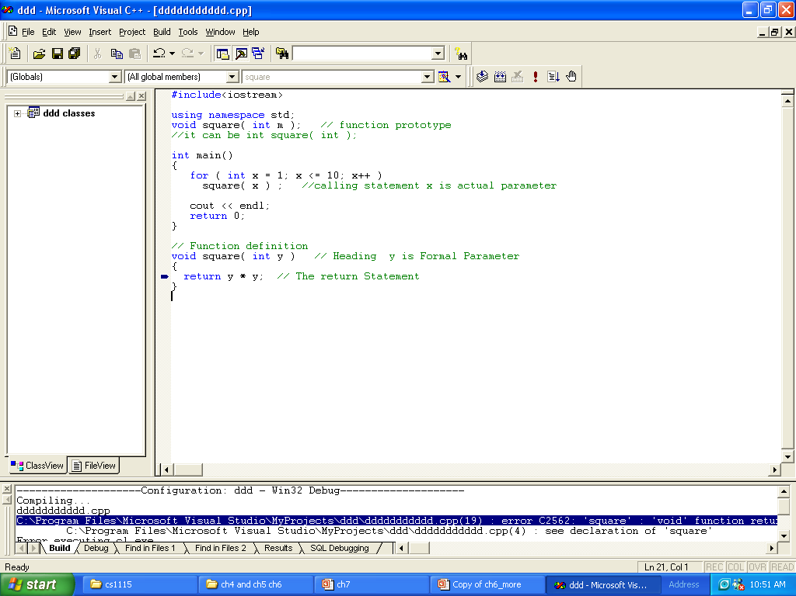

Slide 5
solution
#include<iostream>
using namespace std;
void square( int m ); // function prototype
//it can be int square( int );
int main()
{
for ( int x = 1; x <= 10; x++ )
square( x ) ; //calling statement x is actual parameter
cout << endl;
return 0;
}
// Function definition
void square( int y ) // Heading y is Formal Parameter
{
return y * y; // The return Statement
}

Slide 6
#include<iostream>
using namespace std;
void square( int m ); // function prototype
//it can be int square( int );
int main()
{
for ( int x = 1; x <= 10; x++ )
square( x ) ; //calling statement x is actual parameter
cout << endl;
return 0;
}
// Function definition
void square( int y ) // Heading y is Formal Parameter
{
cout<< y * y<<endl; // The return Statement
}

Slide 7
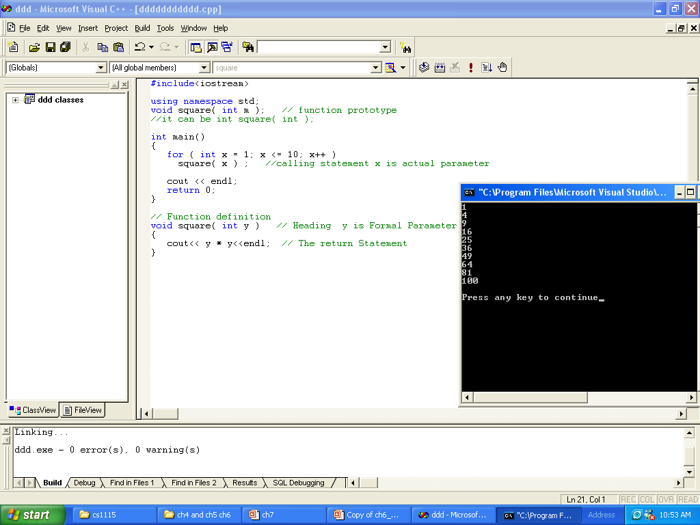

Slide 8
)Reference and Value parameters)

Slide 9
Modify (Value parameters)
#include<iostream>
using namespace std;
void modify( int m ); // function prototype
int main()
{
int x;
x=7;
cout<<"x befor calling modify function = "<<x<<endl;
modify( x ) ; //calling statement x is actual parameter
cout<<"x After calling modify function = "<<x<<endl;
cout << endl;
return 0;
}
// Function definition
void modify( int y ) // Heading y is Formal Parameter
{
y=y+10; // The return Statement
cout<<"y inside modify function = "<<y<<endl;
}

Slide 10
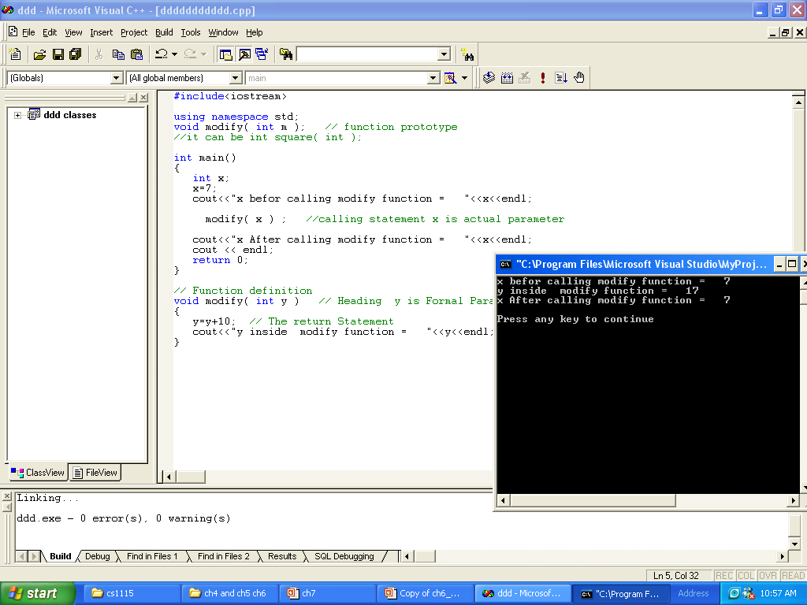

Slide 11
Reference parameters
#include<iostream>
using namespace std;
void modify( int &m ); // function prototype
int main()
{
int x;
x=7;
cout<<"x befor calling modify function = "<<x<<endl;
modify( x ) ; //calling statement x is actual parameter
cout<<"x After calling modify function = "<<x<<endl;
cout << endl;
return 0;
}
// Function definition
void modify( int &y ) // Heading y is Formal Parameter
{
y=y+10; // The return Statement
cout<<"y inside modify function = "<<y<<endl;
}

Slide 12
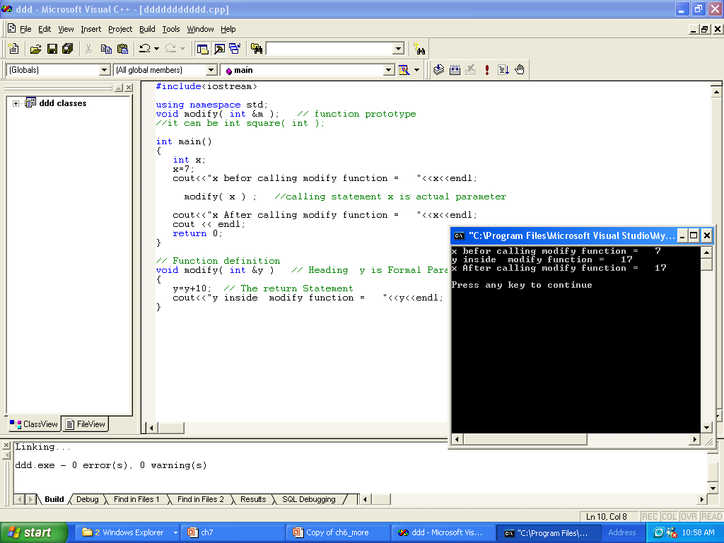

Slide 13
Reference
// References must be initialized
#include <iostream>
using namespace std;
int main()
{
int x = 3, &y = x; // y is now an alias for x
cout << "x = " << x << endl << "y = " << y << endl;
y = 7;
cout << "x = " << x << endl << "y = " << y << endl;
return 0;
}

Slide 14
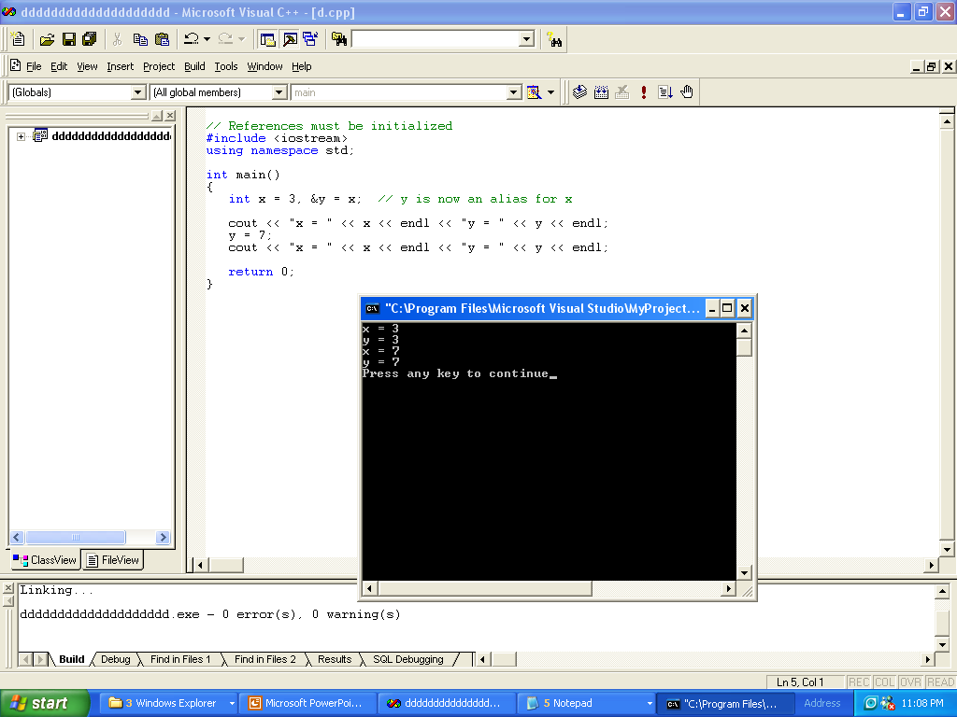

Slide 15
// A scoping example
#include <iostream>
using namespace std;
void a( ); // function prototype
void b( ); // function prototype
void c( void ); // function prototype
int x = 1; // global variable
int main()
{
int x = 5; // local variable to main
cout << "local x in outer scope of main is " << x << endl;
{ // start new scope
int x = 7;
cout << "local x in inner scope of main is " << x << endl;
} // end new scope
cout << "globel x in outer scope of main is " << ::x << endl;
cout << "local x in outer scope of main is " << x << endl;
cout<<"*************************************************"<<endl;
a(); // a has automatic local x
b(); // b has static local x
c(); // c uses global x
cout<<"*************************************************"<<endl;
cout<<"Afetr second calling"<<endl;
a(); // a reinitializes automatic local x
b(); // static local x retains its previous value
c(); // global x also retains its value
cout <<endl<< "local x in main is " << x <<endl<< endl;
return 0;
}
5
7
1
5
5

Slide 16
void a( )
{
int x = 25; // initialized each time a is called
cout << endl << "local x in a is " << x
<< " after entering a" << endl;
}
void b( )
{
static int x = 50; // Static initialization only
// first time b is called.
cout << endl << "local static x is " << x
<< " on entering b" << endl;
x=x+2;
}
void c( void )
{
cout << endl << "global x is " << x
<< " on entering c" << endl;
x *= 10;
}
25
25 in second call
50 in first call
52 in Second call call
1
10 after second call

Slide 17
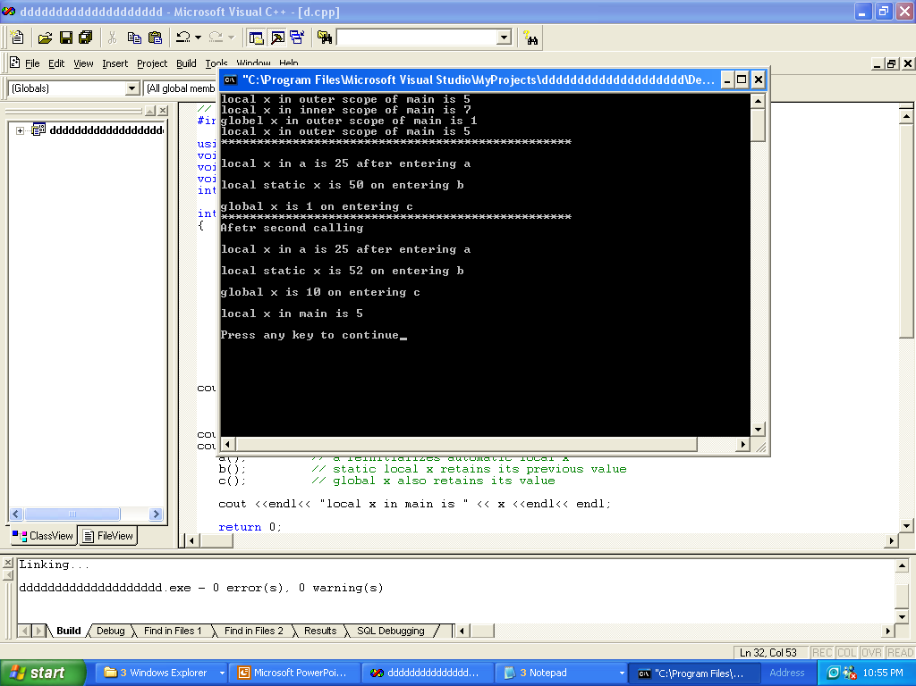

Slide 18
// Using overloaded functions
// Using overloaded functions
#include <iostream>
using namespace std;
int square( int x );
double square( double y );
int main()
{
cout << "The square of integer 7 is " << square( 7 )<<endl
<< "The square of double 7.5 is " << square( 7.5 )
<< endl;
return 0;
}
int square( int x )
{
return x * x;
}
double square( double y )
{
return y * y;
}

Slide 19
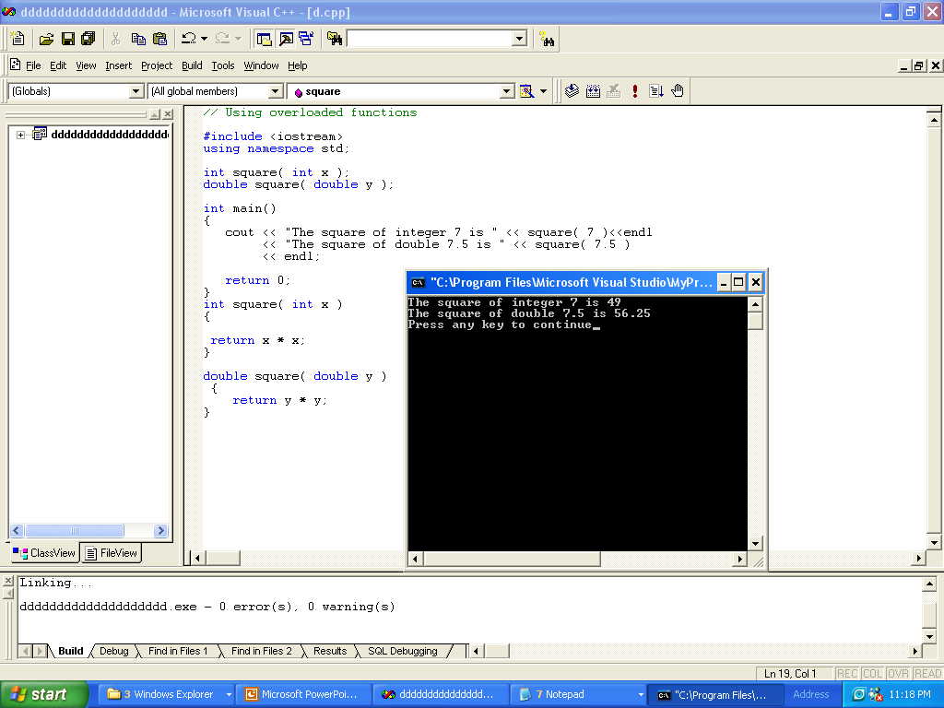

Slide 20
// Using default arguments
// Using default arguments
#include <iostream>
using namespace std;
int boxVolume( int length = 1, int width = 1, int height = 1 );
int main()
{
cout << "The default box volume is: " << boxVolume()
<<endl;
cout<< "width 1 and height 1 is: " << boxVolume( 10 )
<< endl;
cout << "width 5 and height 1 is: " << boxVolume( 10, 5 )
<< endl;
cout << "width 5 and height 2 is: " << boxVolume( 10, 5, 2 )
<< endl;
return 0;
}
// Calculate the volume of a box
int boxVolume( int length, int width, int height )
{
return length * width * height;
}

Slide 21
